Slide 1
Writing Nuts & Bolts

Slide 2
The Writing Nuts & Bolts Presentation Includes:
Big Picture Decisions
Grammar and Syntax
Dialogue
Style
Revising
Standard Manuscript Formatting
www.coachbacon.com

Slide 3
Big Picture Decisions

Slide 4
Audience
Middle Grade Protagonist age 8-13 Wordcount: Lower MG 20 – 30K; Upper MG 30 – 60K
Young Adult Protagonist age 14 – 18 Wordcount: 55 – 80K
Adult Protagonist over 18 Wordcount: 75– 95K
Fantasy is always longer!
www.coachbacon.com

Slide 5
Point of View (POV)
First person Everything you write, see, hear is from your protagonist’s perspective. Readers get inside their head.
Second person (rare for novels) Write directly to the reader, using “you” statements and directives.
Third person (close or omniscient) Write from outside the story, all characters named.
www.coachbacon.com

Slide 6
Tense (Because 2020)
Present uses present-tense verbs:
Great way to build tension, put readers right at the action, less time for thinking, higher emotions
Past uses past-tense verbs
A little more relaxed, allows for narrator’s perspective with time, gives readers time to settle in
You know the narrator will survive to tell the tale
Future tense is rare, often used with second person POV
www.coachbacon.com

Slide 7
Trickle Truthing
Leave room for the reader to digest
Synapses keep their brains working and interested; spoon feeding bores them (Thanks, Andrew Karre!)
Show readers exactly what they need, and no more
Fab’s uncle is dead
He was murdered
It’s unsolved
Also, the dude you already hate did it
www.coachbacon.com

Slide 8
Beware of Stereotypes
Stereotypes perpetuate hurtful lies and misconceptions.
If only your male characters make good decisions, what are you saying about women?
If a father is angry to have only daughters, what does that say about women?
Are all your “bad” characters of a specific race?
Do your athletes need to be stupid?
Do your blondes need to be airheads?
www.coachbacon.com

Slide 9
Beware of Insults
If you need a misogynist in your book, the things he says, how he says them, and how your protagonist deals with that will speak volumes. There must be consequences, or you’re saying it’s okay.
If your plot necessitates bullying of a queer kid:
Do you want to add another iteration of the word “f----t” in media?
If a queer kid is bullied in your book, there MUST be consequences, or you’re putting more of that bullying into the world
www.coachbacon.com

Slide 10
Appropriation, Appreciation, Representation
Appropriation is taking an aspect of another culture and using it as your own or using it inappropriately
Appreciation is learning about another culture and seeking to understand it
Representation is including as secondary characters WELL-RESEARCHED cultures and identities outside your lived experience
Protagonist hangs a cool dreamcatcher over their bed.
Protagonist understands the dreamcatcher’s meaning on a deep level, attributes the cultural item to Ojibwe people they know, hangs dreamcatcher over their bed.
Indigenous character owns dreamcatcher as an important aspect of her Ojibwe culture and lived experience
www.coachbacon.com

Slide 11
Beware of Tropes
A trope is a common, often overused character or device. How can you turn them on their head?
Wicked stepmother
Damsel in distress
The chosen one
Mad scientist
Dumb muscle
Trusty sidekick
Love triangle
Enemies to lovers
Atonement
Bad guys wear black
Ticking clock
Literary Devices! (We’ll get to those soon)
www.coachbacon.com

Slide 12
Grammar and Syntax

Slide 13
The Truth about Grammar
(It’s a tool of oppression)

Slide 14
Subject-Verb Agreement
A single subject uses the singular verb:
Dom is writing
Dom and April are writing
When you’ve chosen a tense for a manuscript, you’ll use that tense throughout except when:
Inserting backstory (past or past perfect)
Imagining/dreaming/wishing (conditional)
www.coachbacon.com

Slide 15
Everything Needs to Agree
When you add a clause to a sentence, the clause modifies the subject of the previous clause:
Britt bought a sailboat, all bright and shiny. (Britt is the bright and shiny thing here, because she was the subject of the last clause.)
When you use a pronoun, the antecedent should be clear.
Nicole and Saj ate the sandwiches her mom made. (Whose mom is the chef?)
www.coachbacon.com

Slide 16
Verbs Make your Manuscript Go
Cut the passive ones
Cynthia had been given a million dollars → Cynthia received a million dollars
April had been received by the Queen → The Queen received April
Choose the best ones
Badly wanted → desired
Had a lot of heat → radiated
Charge up → invigorate
www.coachbacon.com

Slide 17
Did the Romans Get it Wrong?
Stodgy grammarians suck!
Latin left us with some grammatical issues. Stodgy grammarians say:
Don’t split infinitives:
Cynthia used to secretly sleep during class → Cynthia secretly used to sleep during class
Don’t end sentences with prepositions:
What are you listening to? → To what are you listening?
www.coachbacon.com

Slide 18
The Word Only
Put your “only” at the last possible moment:
I only see bears (I cannot smell or feel them)
I see only bears (I cannot see anything else)
I only love you (I don’t date or kiss or admire you)
I love only you (You’re the only person I love)
www.coachbacon.com

Slide 19
Thinking and Feeling
Your protagonist should do at least as much feeling as thinking unless:
They’re completely cerebral
They’re neuro-atypical
They’re a cold, calculated monster
www.coachbacon.com

Slide 20
Specifics and Generalities
Writers who hope to seem relatable by writing in generalities instead feel generic
Writing in specifics makes your character believable
Writing in specifics gives readers something to latch onto
He chugged three cans of soft drink.
He chugged three cans of RC.
He chugged three cans of RC.
Dude must be desperate AF!
www.coachbacon.com

Slide 21
Now, About Commas
Use commas to separate clauses, dialogue, and items in lists:
Britt’s house is warm and cozy, but she’d rather be in Hawaii right now.
Saj said, “This year is rough.” “No kidding,” said Cynthia.
Nicole is a great writer, an amazing listener, a daring skydiver, and a fierce chess player.
www.coachbacon.com

Slide 22
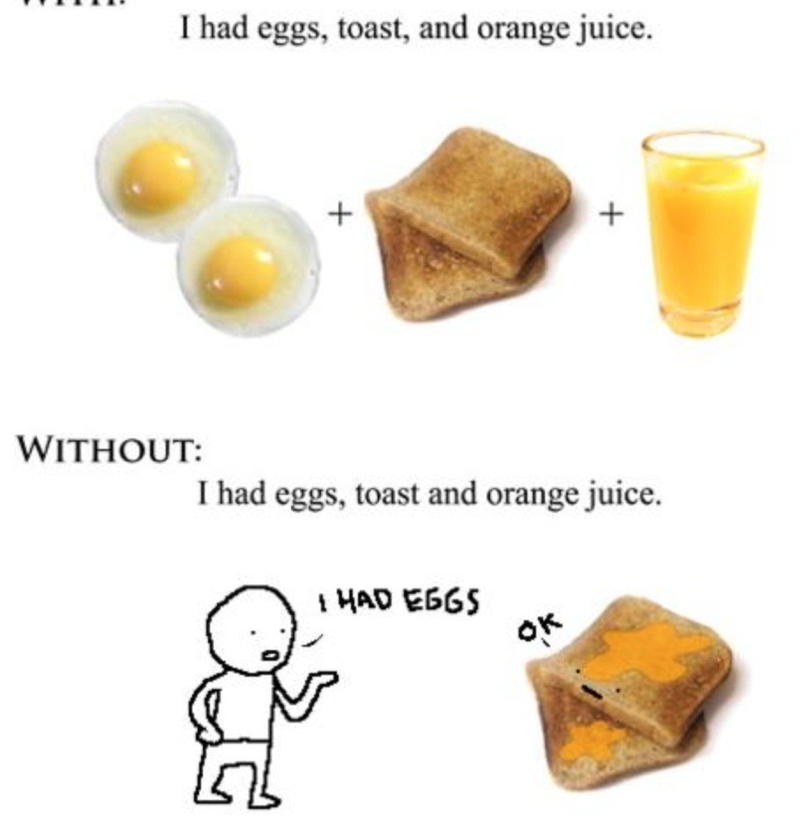
Team Oxford Comma
The Oxford comma, or serial comma, goes before the last item in a series. It isn’t required, but do be consistent.
We went caroling with our dogs, Grandma and Grandpa
I invited clowns, Dom and Britt. “I invited clowns: Dom and Britt.”
I invited clowns, Dom, and Britt “I invited clowns, (as well as) Dom and Britt.”
Most confusion about lists is deliberate. (See note about stodgy grammarians.)
www.coachbacon.com

Slide 23
Words to Cut
Filter words: I can see, I can hear, I think
Stand up/sit down/rise up/climb up/descend down
Start to/Begin to/Decide to/Try to (Start writing→ Writing)
Almost every iteration of:
That
Just
Would
Then
www.coachbacon.com

Slide 24
And Almost Every Iteration of
Very
Go (verb) (Go running → Run)
Seem to
Like (meaning ”as if”)
Of course
Suddenly/Immediately
Actually, really
All other adverbs
www.coachbacon.com

Slide 25
Beware Redundancy (1/2)
Reason why
Whether or not
End result
Full gamut
Close proximity
ATM machine
Exact same
Blend together/Gather together
Reason
Whether
Result
Gamut
Proximity
ATM
Same
Blend/Gather
www.coachbacon.com

Slide 26
Beware Redundancy (2/2)
Orbit around
Personal friend/personal opinion
Plan ahead
Skirt around
Follow after
Free gift
General consensus
Equally as
Orbit
Friend/Opinion
Plan
Skirt
Follow
Gift
Consensus
Equally
www.coachbacon.com

Slide 27
Commonly Confused(1/7)
Use each other for two. Use one another for more.
April and Saj befriended each other.
Nicole, Cynthia, Dom, and Britt befriended one another.
There is a place. Their is possessive. They’re is a contraction meaning they are:
Everyone knew the Library Bar, so we met there.
Saj and Cynthia brought their mothers.
One mother said, “Oh! They’re meeting with a class!”
www.coachbacon.com

Slide 28
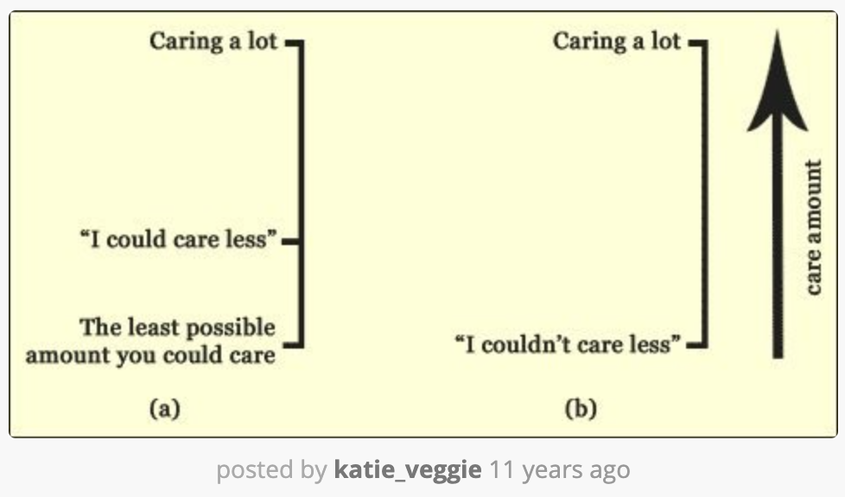
Commonly Confused(2/7)
Could care less means you care at least a little
Couldn’t care less means you care not at all
www.coachbacon.com

Slide 29
Commonly Confused(3/7)
Then gives context in time; Than indicates a comparison:
Michele forced down the baked beans. Then she prepared for gas. (Still, cut most instances of then!)
It’s later in Brooklyn than in Seattle
Your is possessive. You’re means you are:
Your homework is late
You’re working through a pandemic, so no big deal
www.coachbacon.com

Slide 30
Commonly Confused(4/7)
Effect is a noun. Affect is (almost always) a verb.
April opened her umbrella; the effect was immediate.
How did the pandemic affect Cynthia’s move?
In psychology, “affect” is sometimes used as a noun. Are you a psychologist? Are you writing a psychological analysis? If not, affect is a verb.
www.coachbacon.com

Slide 31
Commonly Confused(5/7)
Apostrophes are for possessives and contractions, not plurals
Nicole’s shoes are wet.
Nicole’s working late tonight.
NOT: Nicole bought three pairs of shoe’s.
Its is an exception to that rule. Its is possessive. It’s is only a contraction meaning either it is or it has.
My cat licked its butt
It’s been a long quarantine.
www.coachbacon.com

Slide 32
Commonly Confused(6/7)
Use I when you are the subject and me if you are the object:
April and I talked about corgis.
Nicole shared her writing with April and me.
Use who if referring to a subject and whom when referring to an object. This means whom almost always needs a preposition
Who do you love?
You gave your heart to whom?
www.coachbacon.com

Slide 33
Commonly Confused(7/7)
Who’s inquires about a person, and means Who is? Whose inquires about possession
Who’s on the phone?
Whose cake is this?
Use who when modifying people. Use that to modify everything else.
Michele’s the adult who wears red hooded footie pajamas.
www.coachbacon.com

Slide 34
Dialogue

Slide 35
Punctuating Dialogue
Perfectly serviceable dialogue looks like this:
“Ice cream is infinitely better than cake,” Britt said. “I could eat ice cream all day.”
Michele said, “Team cake all the way.”
Britt spooned a dollop of fresh whipped cream into her bowl and pushed through.
“I prefer candies and licorice to ice cream AND cake,” said April.
www.coachbacon.com

Slide 36
To Reiterate:
Start and end with quotation marks.
Quotes start with capital letters.
Punctuation goes inside the quotation marks.
If you’re adding dialogue tags, use commas:
“Something,” said someone. Someone said, “Something.”
Only one person can speak in a paragraph.
Dialogue tags can come first, last, or in the middle.
Ditto for narrative:
www.coachbacon.com

Slide 37
Insert Narrative First, Last, or in the Middle
“Ice cream is infinitely better than cake,” Britt said through a mouthful of fudge and rocky road. “I could sit here all day.”
“Team cake all the way. They should cut it already,” Michele said.
Britt spooned a dollop of fresh whipped cream into her bowl and plunged in again.
April rolled her eyes. “I prefer candies and licorice to ice cream AND cake.”
www.coachbacon.com

Slide 38
Dialogue Tags
Everything you learned in school is wrong.
Characters rarely exclaim, enunciate, or ejaculate.
Use said except in rare circumstances when volume is important
Melania said, “I’m leaving you.” “I don’t care, do you?” Don screeched.
www.coachbacon.com

Slide 39
Tips and Tricks
Every section of dialogue needs a purpose
Every sentence of dialogue needs a purpose
Why are they at this wedding?
Why are these three disagreeing?
Why is each character fond of what you’ve chosen?
What role do sweets and these preferences play in your manuscript?
www.coachbacon.com

Slide 40
Keeping it Natural
Beware dialogue that’s meant to be overheard by the reader.
People don’t say, “Remember, Nicole, we’re best friends.” Only someone with a degenerative brain condition or TBI would forget that fact. If that’s the case, go for it!
Any time you can move the narrative forward while moving your dialogue forward, you’re winning.
The best way to know whether your dialogue sounds natural is to read it aloud.
www.coachbacon.com

Slide 41
Style

Slide 42
Showing v Telling
If you must do both, show first
Don is a jerk.
My tiny business was thrilled to win a $100,000 contract for Don’s new casino, but 90 days after I’d delivered and tuned a dozen pianos, he refused to pay me.
We’ve been friends nearly 20 years, but when my wife refused Don’s advances, he called us disloyal and slandered us on Flocks News.
www.coachbacon.com

Slide 43
Incorporating Backstory
Especially at the beginning of a manuscript, don’t incorporate too much backstory. (If all that backstory is necessary at the start, you started your story in the wrong place)
Hinting at backstory is the best. It forces your readers’ synapses to fire
Insert backstory in as few words as possible, < a paragraph
Longer bits of backstory pull your reader—and you! The writer!—out of the story you’re telling
Don’t let it carry your reader away…at least not yet
www.coachbacon.com

Slide 44
Details
We talked about shoes on Monday. What characters wear is not important, unless it’s a character tag OR:
It makes their butt look cute and that’s important to your character, or
She’s in a uniform that means something to the story, or
She’s a model, or
She later uses that bandana to bind someone’s wrists, or
She’s naked. Naked is probably important
www.coachbacon.com

Slide 45
Details, Details
Every single detail in your book (character, scene, description, sentence, bit of dialogue) should inform readers:
About your protagonist, or
About how your protagonist sees the world, or
About her heart’s desire, or
About her relationship to someone else, or
Something crucial about the setting
Celeste Ng is a master at this
www.coachbacon.com

Slide 46
Putting Your Sentences to Work
We know every part of your manuscript needs a purpose.
Can you go one step further and make some sentences do two jobs? Or three? Or more?
“On one side of the glass doors are the long lines of people with their photos and papers the prove they belong here in America, that they are allowed to taste a bit of this free air.”
“Even with a few lampposts dotting the streets, I can’t see the breadth and depth of this city that is my birthplace, that is now my home.” (both quotes from Zoboi’s American Street)
www.coachbacon.com

Slide 47
Powerful Words
Some words are more powerful than others. A few words tell a whole story on their own and force a reader’s synapses to fire:
No way Saj was committing a felony again
I could not date another white man.
With seven marriages behind me, I was about to end one for the first time
Cynthia always takes the 5:13 down Belmont
April had a birthday cake once
www.coachbacon.com

Slide 48
Use All the Five Six Seven Senses
Unless your protagonist lacks one of the first five, use them ALL as you write
Sight
Hearing
Taste
Smelling
Touch
The so-called “sixth sense”
Balance
Space (Proprioception/Spatial Orientation)
Pain and other internal sensations
www.coachbacon.com

Slide 49
Stage Directions
Moving a character without connecting that movement to thoughts and feelings is considered stage directions. Unless you’re a playwright, use them only when absolutely necessary:
They lifted a mug of coca to their lips → They sipped the cocoa. (But only if it’s laced with CBD or is otherwise important)
I entered the bedroom and opened my closet door → I dashed to the closet to find it bare. (But only if this is new)
I threw off the covers, climbed out of bed, walked to the bathroom, closed the door, and sat on the toilet. → (But only if she’s taking a pregnancy test or constipated for a sixth day)
www.coachbacon.com

Slide 50
Literary Device: Metaphors
A metaphor compares two things by saying one thing is the other. Use metaphors that reflect your unique outlook. Here are some tired metaphors, but you’ll get my point:
Life is a highway
Love is a battlefield
All the world’s a stage
A simile is a metaphor that uses like or as (usually as XXX as)
She’s as fun as a barrel of monkeys
They fight like cats and dogs
www.coachbacon.com

Slide 51
Literary Device: Imagery
Imagery is figurative and metaphorical language used to create an image in the mind of the reader. Use descriptive language to engage all the senses (but not all at once)
Red → crimson or burnt red
Quiet → eerie silence
Scent → stench of rotting compost
Uncomfortable → starched fabric on my skin
Savory → a smooth vegetarian lasagne with chunks of tomato
www.coachbacon.com

Slide 52
Literary Device: Foreshadowing
Foreshadowing is hinting at events to come. Good foreshadowing creates curiosity or suspense
Reveal only as much as you must, then trickle truth readers until the reveal.
“If (Moody) had kept (Pearl) to himself, perhaps the future might have been quite different.”
“Though they were still certain, all of them, that this hole (of Izzy’s absence) would be temporary” (Both quotes from Ng’s Little Fires Everywhere)
www.coachbacon.com

Slide 53
Literary Device: Motif
A motif is a repeated element, pattern, symbol ,or image that appears throughout the novel to symbolize something else. Motifs support a book’s theme
Trains symbolizing transition
Plants symbolizing life
Red things symbolizing the dead
Yellow brick road as the journey of life
www.coachbacon.com

Slide 54
Literary Device: Juxtaposition
Juxtapositions places two dissimilar things side by side to emphasize their differences. Sometimes the best way to understand what something IS is to know what it is NOT
A happy couple next to an unhappy couple
An elephant next to a human
A saint speaking to an imprisoned murderer
Moral v. amoral
Embrace the contrast!
www.coachbacon.com

Slide 55
Literary Device: Synecdoche
Synecdoche is using a part of something to stand in for the whole of the thing:
“wheels” for a car
“The White House” is the presidency
“Threads” means clothing
“Lend me your ears” means your complete attention
“Suits” refers to people in business
www.coachbacon.com

Slide 56
Revising

Slide 57
Engage Your Community
Call in your favors! Ask your friends, your family, your writing colleagues, your critique group, and your classmates to read your manuscript and give you all their comments
When the comments return, you’ll know who your best readers are. People who love everything you do are nice to have around, but they’re not your best readers. Your best readers ask lost of questions
Don’t get defensive; get busy. You can write whatever you like, but if your readers have consensus (Andrew stinks!) you may need to change the manuscript
www.coachbacon.com

Slide 58
What Do You Want to Say?
When you’re done writing, consider what your novel says
Ask your early readers what your manuscript says
Is that what you’d intended to say?
Once you understand what your novel says and what you want it to say, revise
Within that revision, tilt every chapter, every scene, every paragraph, every sentence toward that end (Thanks, Barbara Kingsolver.)
www.coachbacon.com

Slide 59
Find Your Own Challenges
After a month away from the manuscript, your fresh eyes will find HEAPS of errors, and that’s great!
Allow yourself to read without editing. Take notes (on a hard copy or in your word processor,) but resist the urge to edit
Examine your story flow, your character, your dialogue, your descriptions
Identify and acknowledge your shortcomings. Consider making a list so you can focus on purging them from your work
www.coachbacon.com

Slide 60
How much can you cut?
Start by cutting all of these:
Every scene that doesn’t move the protagonist closer to or further from her goals
Every character who doesn’t have a purpose
Every unnecessary or reiterative paragraph
Every unnecessary or reiterative sentence
Every unnecessary or reiterative word
www.coachbacon.com

Slide 61
What Must You Add?
Your community will have ideas.
You will have ideas.
You might have ideas for New Stuff To Add. Be wary of this, as adding a new character, issue, treasured token, or problem in chapter 17 will feel like a bandage
Weave the new thing through the manuscript to make it believable. This is a lot of work if you need new scenes, new relationships, or a new structure. If it’s small, you can insert a sentence here and there and you’re good
www.coachbacon.com

Slide 62
Guaranteed homework
When I read your full manuscript, I guarantee I will ask you to do the following:
Justify the existence of every character who has a speaking role
Justify every scene; how does it move your protagonist forward or set her back?
Read the whole manuscript aloud or BONUS! have someone else read it aloud to you
www.coachbacon.com

Slide 63
Standard Manuscript Formatting

Slide 64
Full Document (1/2)
Standard manuscript formatting is double spaced with no extra space between paragraphs.
Use one-inch margins on all sides. MS Word likes to start you at 1.5 inches. Change that in your ”Normal” template
Use a 12-point font in Arial or Times New Roman
The first line of every paragraph is indented a half inch. Set this in your word processing application so you needn’t indent every paragraph manually
www.coachbacon.com

Slide 65
Full Document (2/2)
Separate scenes with a centered hashtag on its own line.
Use only one space after punctuation!
Include in your header or footer:
Name
Title
Page number
www.coachbacon.com

Slide 66
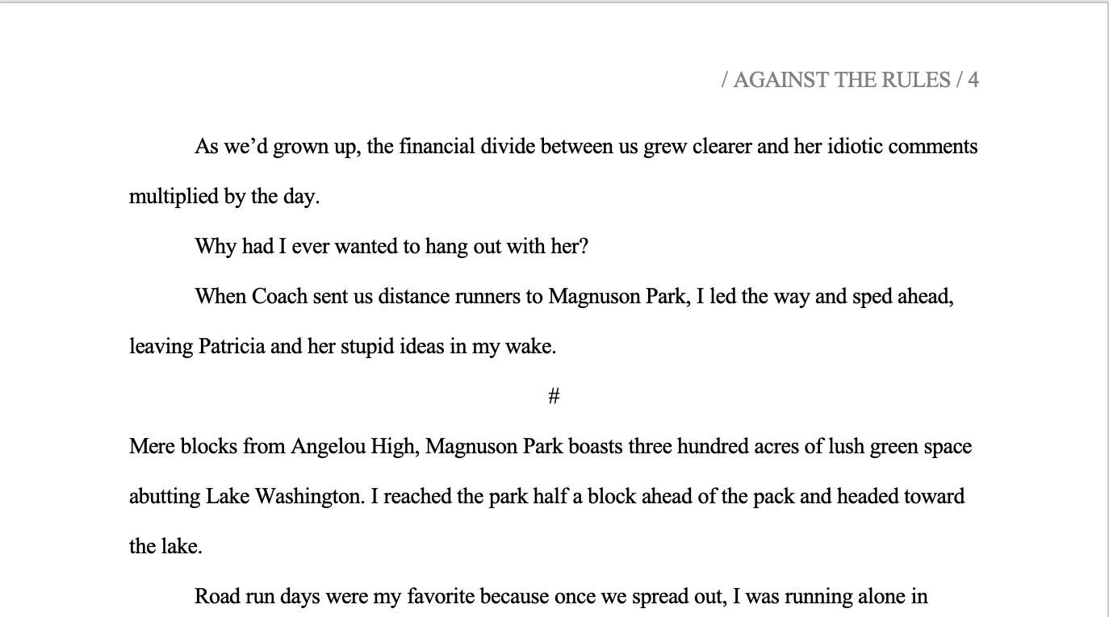
www.coachbacon.com

Slide 67
Title Page
In the upper left corner, single-spaced and justified left, include your name, physical address, email address, phone number, and website (if you have one)
In the upper right corner, single-spaced and justified right, include your genre, audience, and word count
Center your title on the page in all caps
Two spaces below your title, write “By Your Name” on a single line or two
Use no header or footer
www.coachbacon.com

Slide 68
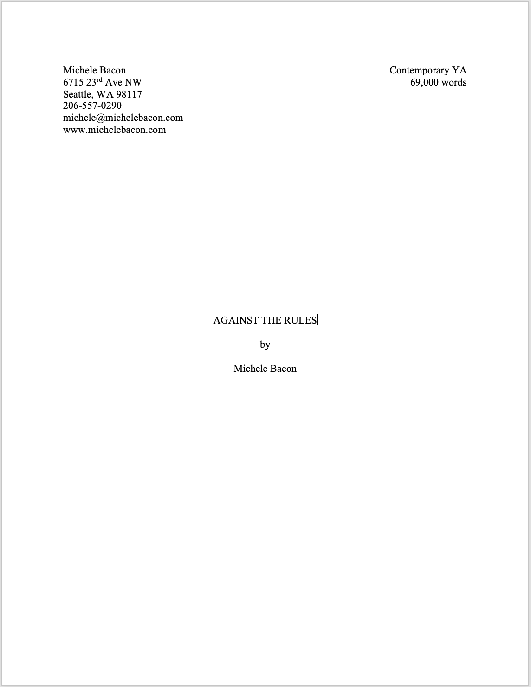
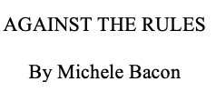
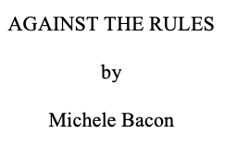
www.coachbacon.com

Slide 69
Chapter Start and Section Start
Every chapter starts on a new page
Place chapter number 1/4 – 1/3 down the page
Numerals (2) and spelled numbers (two) are fine for chapters
Start first paragraph 2-6 lines below the chapter number
First line of first paragraph is justified left
Section starts, after hashtag, start two spaces below the hashtag, also justified left
www.coachbacon.com

Slide 70
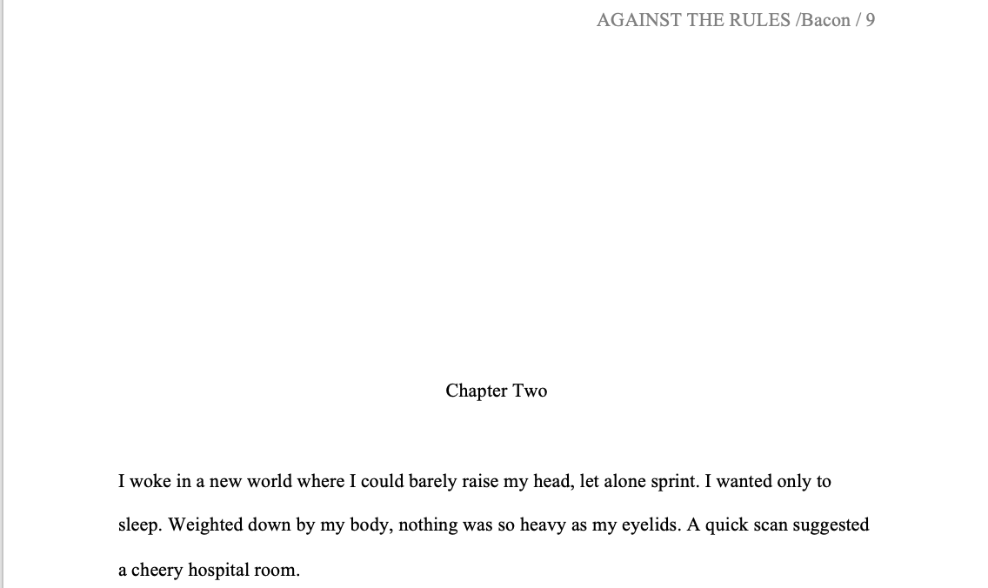
www.coachbacon.com

Slide 71
Questions?

